Slide 1
Enhancing the efficiency of animal-alternative in-silico drug cardiotoxicity prediction through CUDA-based parallel processing CUDA기반 병렬처리를 통한 동물대체 인실리코 약물 심독성 예측 효율성 증대
Iga Narendra Pramawijaya
20236132
Supervisor: Prof. Ki Moo Lim
Department of IT Convergence Engineering, Kumoh National Institute of Technology, Korea
iga@kumoh.ac.kr
December 2024

Slide 2


Introduction
Background
Main Objectives
Cardiovascular diseases are a leading cause of death globally.
Current drug discovery methods, which rely heavily on animal testing, face ethical concerns and limitations in accuracy to predict human drug safety.
In recent years, in silico (computer-based) methods have emerged as a promising alternative.
However, their efficiency is often hindered by the complexity of simulating biological processes, and large samples that being processed.
Develop an efficient in silico cardiotoxicity prediction method capable of handling large sample sizes.
Utilise GPU-based parallel processing with CUDA to accelerate simulations while maintaining accuracy.

Slide 3
CUDA
CUDA (Compute Unified Device Architecture) is a parallel computing platform and programming model developed by NVIDIA. It enables general-purpose computing on NVIDIA graphics processing unit (GPU).
Key Features
Massive Parallelism:
Utilizes thousands of GPU cores to process tasks simultaneously.
Ideal for large-scale computations like in silico simulations.
Flexible Programming Model:
Built on C, C++, and Fortran, making it accessible for developers.
Allows for custom thread and memory management.
Hierarchical Threading:
Threads are grouped into blocks, and blocks form grids.
Supports efficient task distribution for high-performance computing.
Why CUDA for This Research?
Accelerates simulations by distributing tasks across multiple threads.
Leverages GPU’s architecture to handle large datasets efficiently -> Reduces simulation time.

Slide 4
Development Workflow
Model Building
The simulation process was designed to efficiently model cardiac electrophysiology and predict cardiotoxicity under drug-induced and control conditions. Each step leverages CUDA-based GPU parallelization to accelerate processing.
Steps:
Parse CellML models and export to C.
Format C to CUDA
Apply Ordinary Differential Equation Solver
Compile and run CUDA-enabled simulations.
Simulate for 1000 paces, with and without drug effects.
Output time-series data and biomarkers for analysis.
Optimize code
Simulate multiple samples
validation
optimal and valid?
Comparison

Slide 5
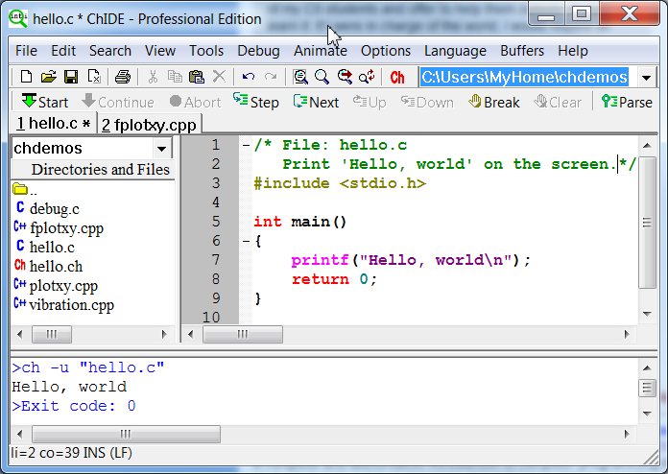

Development Workflow
Parse CellML models and export to C.
Model Selection: Three well-established cardiac cell models (ORd 2011*, ORd 2017**, and ToR-ORd***).
* T. O'Hara, L. Virág, A. Varró, and Y. Rudy, “Simulation of the Undiseased Human Cardiac Ventricular Action Potential: Model Formulation and Experimental Validation.” 2011, PLOS Computational Biology 7(5): e1002061. Available: https://doi.org/10.1371/journal.pcbi.1002061.
** S. Dutta, K.C. Chang, K.A. Beattie, J. Sheng , P.N. Tran, W.W. Wu, M. Wu, D.G. Strauss, T. Colatsky, and Z. Li. "Optimization of an In silico Cardiac Cell Model for Proarrhythmia Risk Assessment." Front Physiol. Aug 2017 doi: 10.3389/fphys.2017.00616.
*** Tomek, Jakub et al. “Development, calibration, and validation of a novel human ventricular myocyte model in health, disease, and drug block.” eLife vol. 8 e48890. Dec 2019, doi:10.7554/eLife.48890.

Slide 6
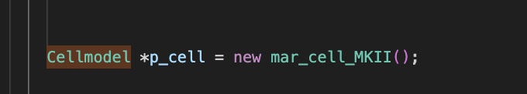
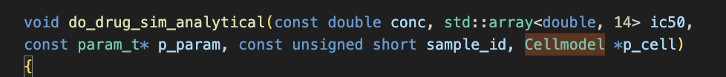
Development Workflow
CUDA Implementation:
Converted CellML models to C, then simplify to CUDA.
Optimized GPU memory allocation (global, shared, constant).
Flattened multidimensional data structures for efficiency.
Before
After

Slide 7
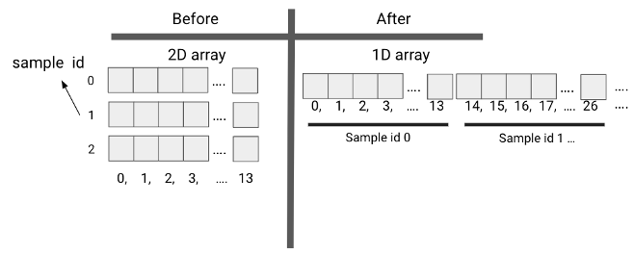
Development Workflow
CUDA Implementation:
Converted CellML models to C code, then simplify to CUDA.
Optimized GPU memory allocation (global, shared, constant).
Flattened multidimensional data structures for efficiency.
There are a total of 223 entries in the algebraic variable array. There are a total of 43 entries in each of the rate and state variable arrays. There are a total of 163 entries in the constant variable array.
ALGEBRAIC[3] = 1.00000/(1.00000+exp((STATES[0]+87.6100)/7.48800))
ALGEBRAIC[(sample_id * 223) + 3] = 1.00000/(1.00000+exp((STATES[(sample_id * 43) + 0]+87.6100)/7.48800));

Slide 8
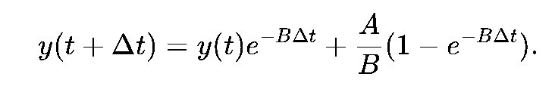
Development Workflow
Rush-Larsen
Models and ODE Solvers:
ORd 2011 (Rush-Larsen solver)
ORd 2017 (Forward Euler solver)
ToR-ORd (Forward Euler solver)
Forward Euler
x_{n+1}=x_{n}+rate(x_{n})⋅Δt
void solveEuler( double *STATES, double *RATES, double dt, int sample_id) { for(int i=0;i<43;i++){ STATES[(43 * sample_id) + i] = STATES[(43 * sample_id) + i] + RATES[(43 * sample_id) + i] * dt; } }

Slide 9
Methodology Development Overview
The study focuses on implementing GPU-based parallel computing for in silico cardiotoxicity prediction. This involves:
CUDA Parallelization: Efficiently utilizing GPU resources for simulation.
Comparison: Validation against CPU-based OpenCOR results.
Models and ODE Solvers:
ORd 2011 (Rush-Larsen solver)
ORd 2017 (Forward Euler solver)
ToR-ORd (Forward Euler solver)
CUDA Implementation:
Converted CellML models to C code.
Optimized GPU memory allocation (global, shared, constant).
Flattened multidimensional data structures for efficiency.
Validation: Results compared with CPU-based OpenCOR simulations.

Slide 10
Simulation Results

Slide 11
Parameters Overview
Accuracy Validation
Ensure GPU-based simulations replicate physiological outputs of CPU-based simulations.
Key Metrics:
Action Potential Duration (APD).
Simulation time (seconds)
Ionic currents: INa, ICaL, IKs, IKr, Ito.
Calcium transients (CaI).
Validation Process:
Compare GPU results with OpenCOR (CPU-based) benchmarks.
Visual alignment of action potentials confirms fidelity.
Common Parameters
1000 paces
1000ms per pace
Performance Metrics
Hardware Used:
GPU: NVIDIA RTX 4090.
CPU: 10-core Intel Xeon @ 2.50 GHz.
Drug-Induced Simulation Parameters
Test Drug: Bepridil, simulated at cmax 1 (33 mMol), cmax 2 (66 mMol), and cmax 4 (132 mMol).
Key Observations:
Action potentials altered predictably with drug effects.
Compare GPU results with OpenCOR (CPU-based) benchmarks.

Slide 12
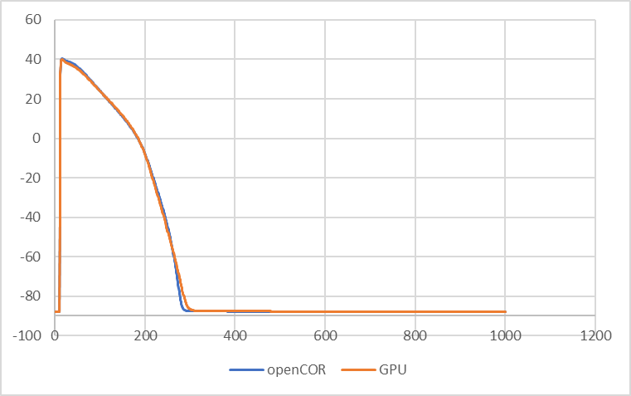
Drug-Free ORd 2011 Result Validation
Action Potential (mV) Shape of both CPU (blue) and GPU (orange) Result Using ORd 2011
The GPU-based simulation for the ORd 2011 model was validated against CPU (OpenCOR) results by comparing action potential plots and key biomarkers like APD under no-drug conditions. The findings showed near-identical outputs, confirming the GPU’s accuracy in replicating physiological dynamics.

Slide 13
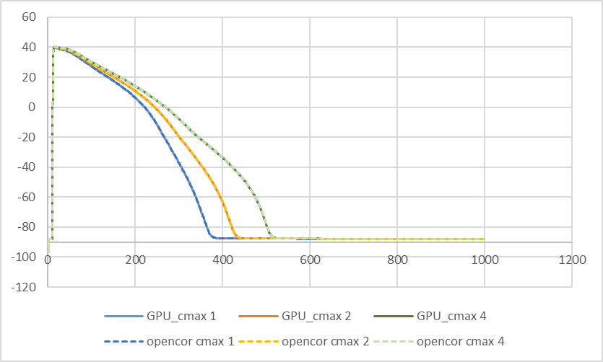
Drug-Induced ORd 2011 Result Validation
Action Potential Shape (mV) of both CPU (dashed) and GPU under drug effect Using ORd 2011
To validate our GPU-based simulation of the ORd 2011 model, we compared its action potential traces and key biomarkers to those generated by a CPU-based simulation (OpenCOR). We consistently applied drug effects to both platforms by adjusting ionic current parameters using IC50 and Hill coefficients. The results demonstrated that the GPU simulation accurately replicated the CPU's output, confirming its reliability in simulating both normal physiological and drug-induced responses.

Slide 14
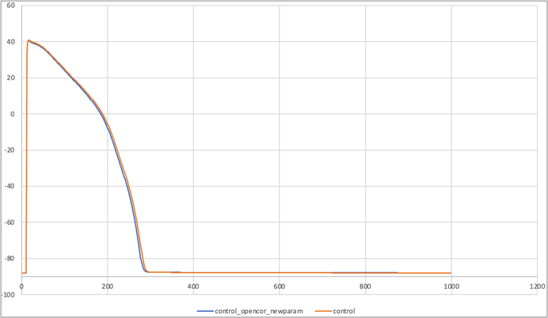
Drug-Free ORd 2017 Result Validation
Action Potential (mV) Shape of both CPU (blue) and GPU (orange) Result Using ORd 2017
The GPU-based ORd 2017 model was validated against a CPU-based reference (OpenCOR). By visually aligning action potential time-series data and analyzing key biomarkers, we confirmed the GPU's accuracy under no-drug conditions. Similar to the ORd 2011 model, the GPU closely replicated the CPU's output, demonstrating its reliability for the ORd 2017 model. Figure 3.4 illustrates the near-identical action potentials from both platforms.

Slide 15
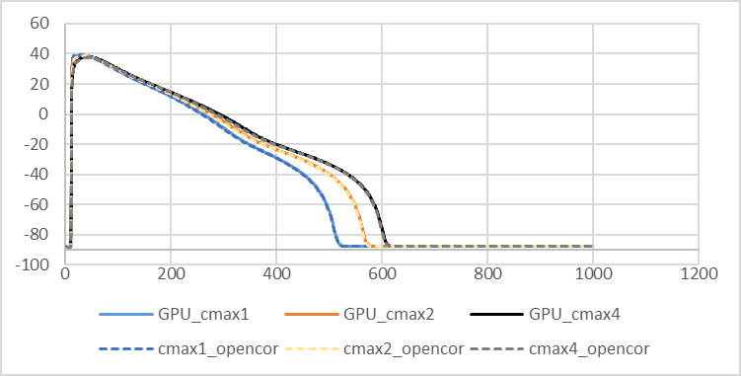
Drug-Induced ORd 2017 Result Validation
Action Potential Shape (mV) of both CPU (dashed) and GPU under drug effect Using ORd 2017
The GPU-based ORd 2017 model was validated under drug conditions by comparing its output to a CPU-based reference (OpenCOR). Drug effects were consistently simulated on both platforms. Analysis of action potential traces and key biomarkers confirmed the GPU's accuracy in replicating physiological and pharmacological responses, even with drug effects.

Slide 16
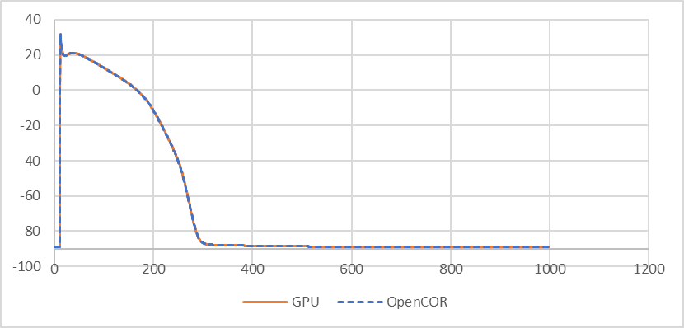
Drug-Free ToR-ORd Result Validation
Action Potential (mV) Shape of both CPU (dashed blue) and GPU (orange) Result Using ToR-ORd
The GPU-based ToR-ORd model was validated by comparing its output to a CPU-based reference (OpenCOR). Time-series plots of action potentials were compared, and key biomarkers were assessed under drug-free conditions. The GPU simulation accurately replicated the CPU results, confirming its reliability for the ToR-ORd model, even with the forward Euler method.

Slide 17
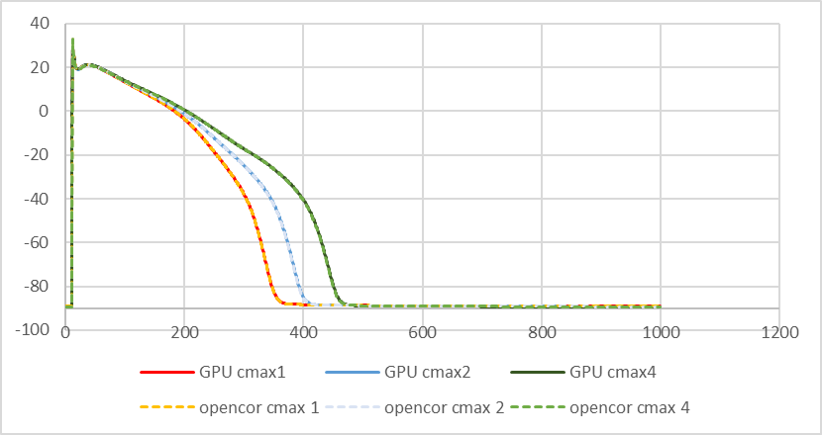
Drug-Induced ORd 2017 Result Validation
Action Potential (mV) Shape of both CPU (dashed) and GPU under drug effect Using ToR-ORd cell model
The GPU simulation accurately replicated the CPU-based simulations for the ToR-ORd model, with no significant differences in action potential traces or biomarkers. This confirms the validity of the GPU-based simulation, even under drug-induced perturbations. The successful validation of drug effects highlights the GPU method's capability to reliably simulate complex pharmacological scenarios, reinforcing its utility as a powerful tool for investigating drug-induced cellular behaviors.

Slide 18
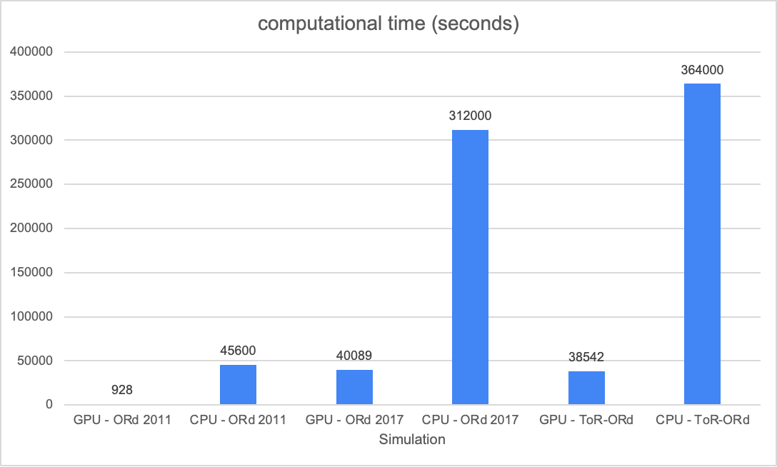
Computational Advantages
For the ToR-ORd model, GPUs outperform CPUs when simulating 847 or more samples, for the ORd 2011 model, it is 163 samples, and 1,028 samples for ORd 2017.
Beyond these thresholds, GPUs significantly reduce computation times, handling large-scale simulations without substantial performance loss.
For instance, simulating 8,000 samples with the ORd 2017 model takes 40,089 seconds on the GPU, compared to 312,000 seconds on a 10-core CPU.

Slide 19
Conclusion
Key highlights:
Demonstrated the effectiveness of CUDA-based GPU parallelization for in silico drug cardiotoxicity prediction.
GPU simulations were up to 40.91x faster (ORd 2011) than 10-core CPU methods, with runtimes remaining constant regardless of sample size.
GPU maintained high similarity in action potentials, biomarkers, and drug-induced effects across all models when compared to CPU.
Impact:
Accelerates preclinical testing, reduces reliance on animal models, and lowers complexity in drug discovery processes.
This study positions GPU-based simulations as a transformative tool in the pharmaceutical industry, reducing the time, cost, and ethical concerns associated with traditional methods. With continuous development, it has the potential to revolutionize in silico drug discovery.

Slide 20
Thank you
References
1. Jason Sanders and Edward Kandrot. 2010. CUDA by Example: An Introduction to General-Purpose GPU Programming (1st. ed.). Addison-Wesley Professional.
2. “What is OpenMP?” Accessed: Nov. 10, 2024. [Online]. Available: https://cvw.cac.cornell.edu/openmp/intro/what-is-openmp.
3. R. L. Graham, G. M. Shipman, B. W. Barrett, R. H. Castain, G. Bosilca and A. Lumsdaine, "Open MPI: A High-Performance, Heterogeneous MPI," 2006 IEEE International Conference on Cluster Computing, Barcelona, Spain, 2006, pp. 1-9, doi: 10.1109/CLUSTR.2006.311904.
4. A. Garny et al., “CellML and associated tools and techniques,” Sep. 13, 2008, Royal Society. doi: 10.1098/rsta.2008.0094.
5. M. Gómez, J. Carro, E. Pueyo, A. Pérez, A. Oliván, and V. Monasterio, “In Silico Modeling and Validation of the Effect of Calcium-Activated Potassium Current on Ventricular Repolarization in Failing Myocytes,” IEEE J Biomed Health Inform, pp. 1–9, 2024, doi: 10.1109/JBHI.2024.3495027.
6. C. M. Lloyd, J. R. Lawson, P. J. Hunter, and P. F. Nielsen, “The CellML Model Repository,” Bioinformatics, vol. 24, no. 18, pp. 2122–2123, 2008, doi: 10.1093/bioinformatics/btn390.
7. N. Le Novère et al., “BioModels Database: a free, centralized database of curated, published, quantitative kinetic models of biochemical and cellular systems.,” Nucleic Acids Res, vol. 34, no. Database issue, 2006, doi: 10.1093/nar/gkj092.
8. M. Berghoff, J. Rosenbauer, F. Hoffmann, and A. Schug, “Cells in Silico-introducing a high-performance framework for large-scale tissue modeling,” BMC Bioinformatics, vol. 21, no. 1, Oct. 2020, doi: 10.1186/s12859-020-03728-7.
9. M. Martínez-del-Amor, I. Pérez-Hurtado, D. Orellana-Martín, and M. J. Pérez-Jiménez, “Adaptative parallel simulators for bioinspired computing models,” Future Generation Computer Systems, vol. 107, pp. 469–484, Jun. 2020, doi: 10.1016/j.future.2020.02.012.
10. S. McIntosh-Smith, J. Price, R. B. Sessions, and A. A. Ibarra, “High performance in silico virtual drug screening on many-core processors,” International Journal of High Performance Computing Applications, vol. 29, no. 2, pp. 119–134, May 2015, doi: 10.1177/1094342014528252.
11. P. Amar, M. Baillieul, D. Barth, B. LeCun, F. Quessette, and S. Vial, “Parallel Biological In Silico Simulation,” Nov. 2014, doi: 10.1007/978-3-319-09465-6_40.
12. D. G. Whittaker, J. C. Hancox, and H. Zhang, “In Silico Assestment of Pharmacotherapy for Human Atrial Patho-Electrophysiology Associated With hERG-Linked Short QT Syndrome” Jan. 2019, doi: 10.3389/fphys.2018.01888.
13. T. O'Hara, L. Virág, A. Varró, and Y. Rudy, “Simulation of the Undiseased Human Cardiac Ventricular Action Potential: Model Formulation and Experimental Validation.” 2011, PLOS Computational Biology 7(5): e1002061. Available: https://doi.org/10.1371/journal.pcbi.1002061.
14. S. Dutta, K.C. Chang, K.A. Beattie, J. Sheng , P.N. Tran, W.W. Wu, M. Wu, D.G. Strauss, T. Colatsky, and Z. Li. "Optimization of an In silico Cardiac Cell Model for Proarrhythmia Risk Assessment." Front Physiol. Aug 2017 doi: 10.3389/fphys.2017.00616.
15. Tomek, Jakub et al. “Development, calibration, and validation of a novel human ventricular myocyte model in health, disease, and drug block.” eLife vol. 8 e48890. Dec 2019, doi:10.7554/eLife.48890.
16. “Parallel Thread Execution ISA Version 8.5” Accessed: Nov. 24, 2024. [Online]. Available: https://docs.nvidia.com/cuda/parallel-thread-execution/index.html.
17. C., Yves, C. D. Lontsi, and C. Pierre. "Rush-Larsen time-stepping methods of high order for stiff problems in cardiac electrophysiology." 2017, arXiv preprint arXiv:1712.02260.
18. G.R. Mirams, Y. Cui, A. Sher, M. Fink, J. Cooper, B. M. Heath, et al. "Simulation of multiple ion channel block provides improved early prediction of compounds' clinical torsadogenic risk." 2011, Cardiovasc. Res. 91 (1), 53–61. doi:10.1093/cvr/cvr044.

Slide 21
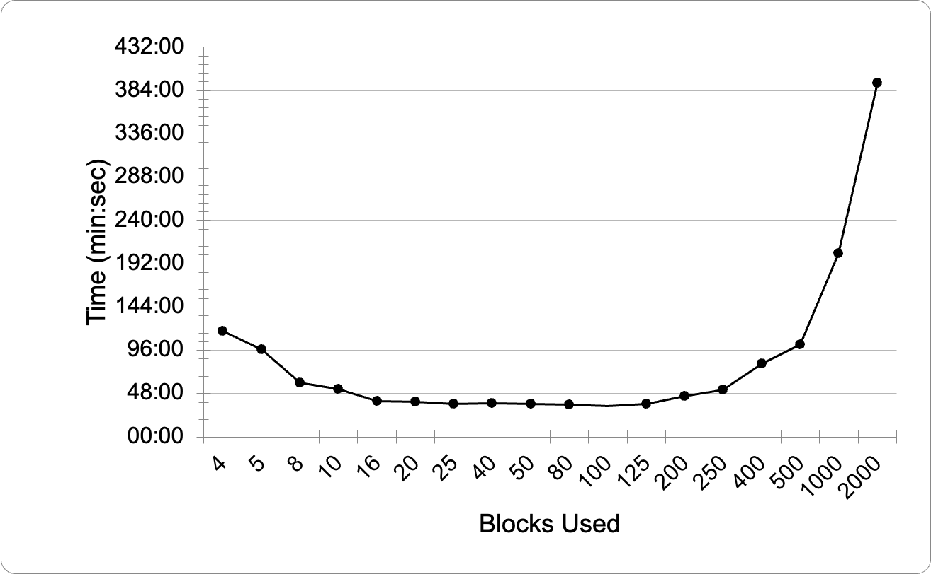
Trial & errors selecting number of thread per block

Slide 22
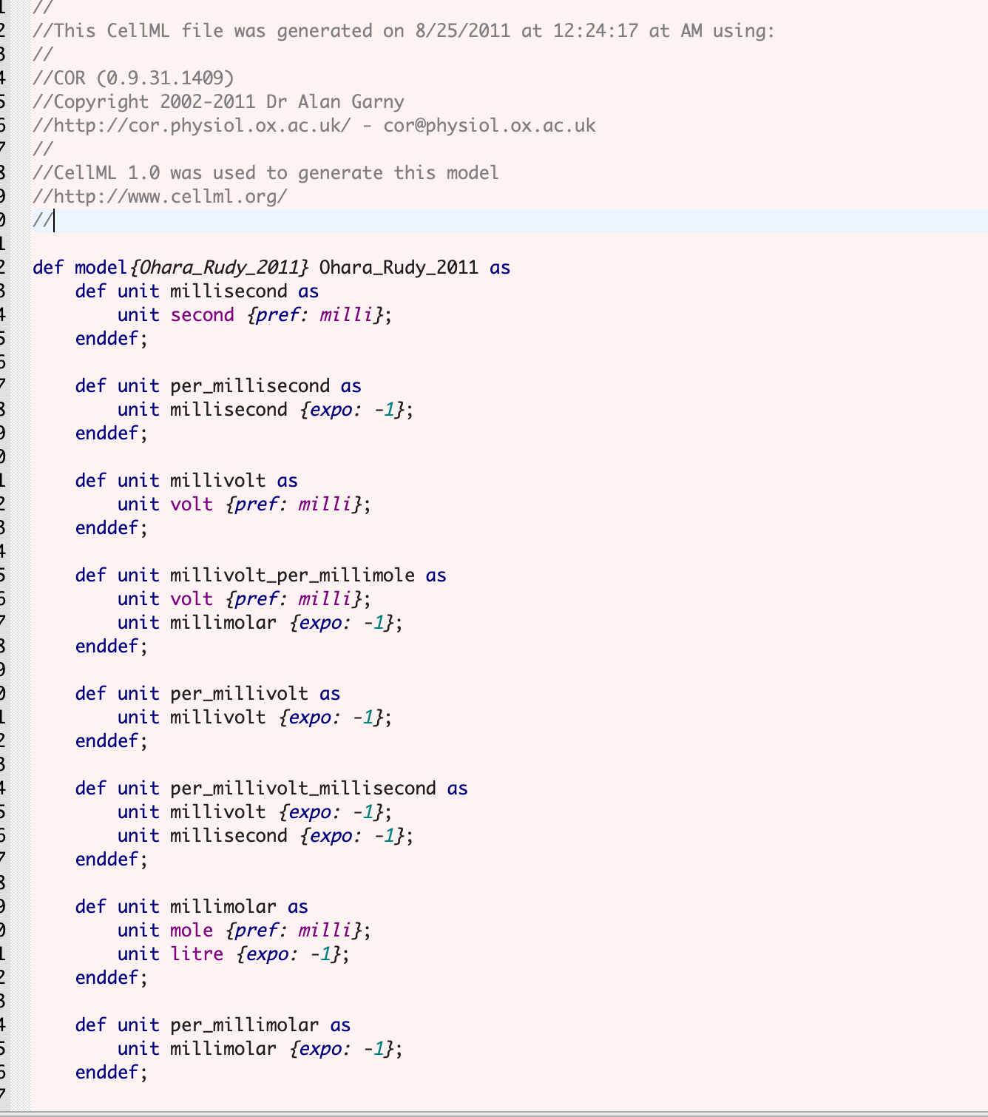
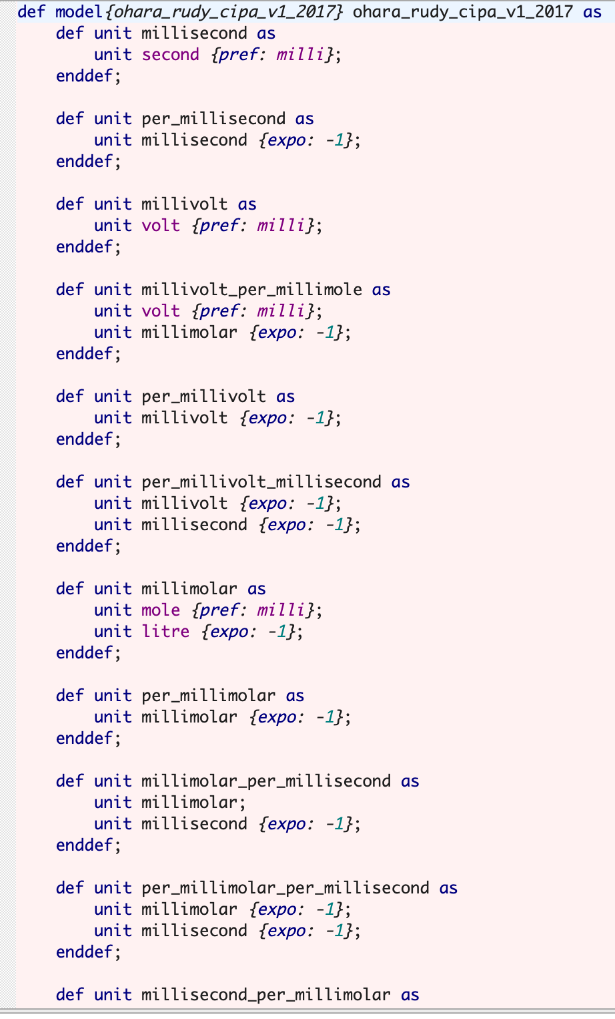
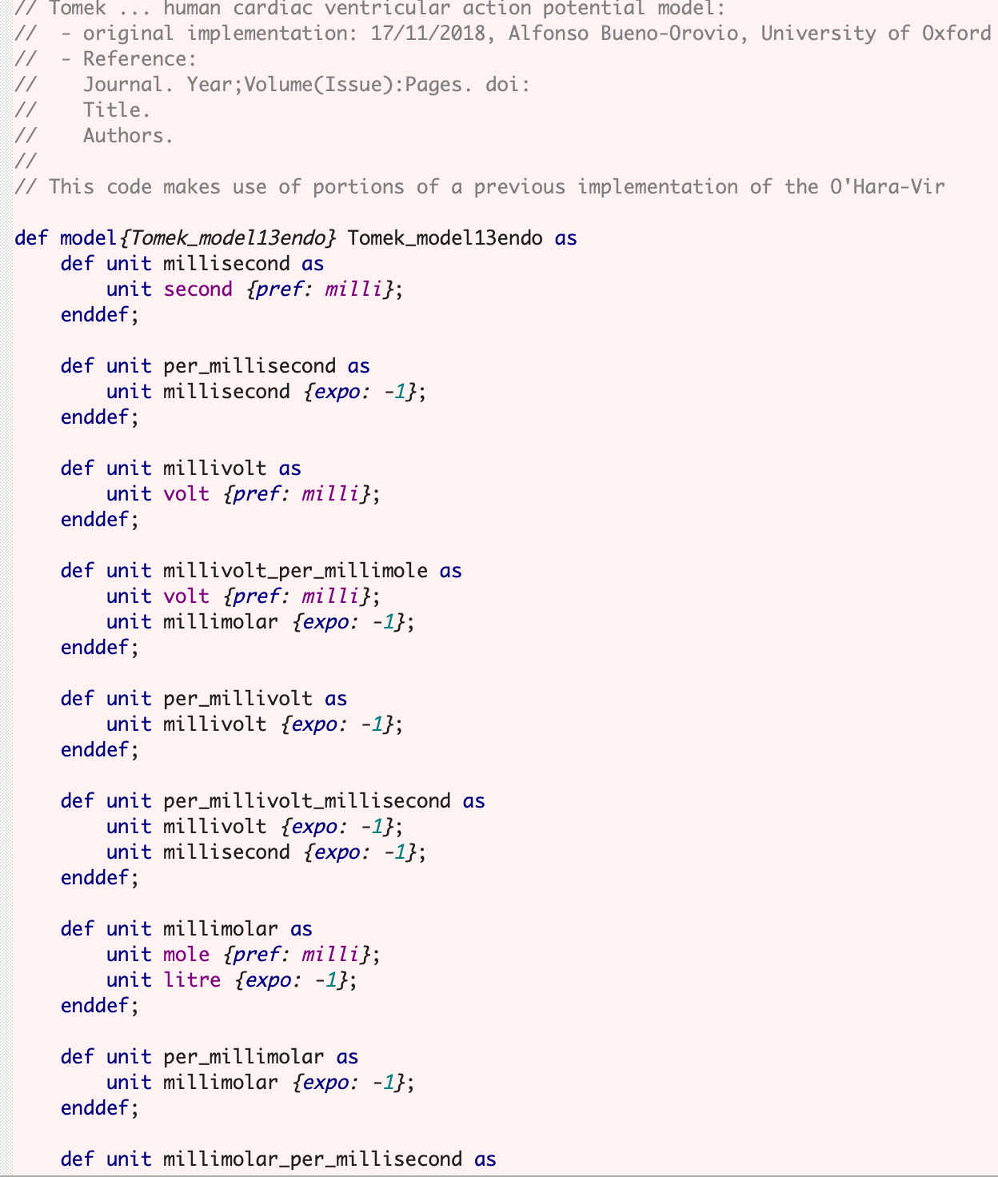
CellML’s XML for ORd 2011, 2017 and ToR-ORd respectively

Slide 23
Rush-Larsen method
The Rush-Larsen method is a semi-implicit numerical technique designed to solve ordinary differential equations (ODEs) efficiently, particularly in biological and electrophysiological simulations like cardiac cell modeling. ORd 2011 included this solver in their paper and source code.
Key Features
Exploits Exponential Solutions:
In cardiac models, gating variables (ion channel states) typically follow equations that resemble exponential decay or growth.
The Rush-Larsen method analytically solves these exponential components, offering higher accuracy and stability for these variables.
Stability:
It is more stable for stiff equations with rapid changes.
Efficiency:
By avoiding full numerical integration for the gating variables, it reduces computational complexity, making it ideal for large-scale simulations.

Slide 24
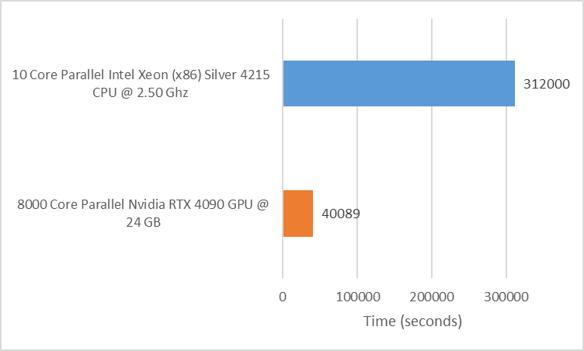
Computational Time in ORd 2017 Simulation
Simulation time comparison between GPU and CPU in ORd 2017
The GPU-based ORd 2017 model was validated under drug conditions by comparing its output to a CPU-based reference (OpenCOR). Drug effects were consistently simulated on both platforms. Analysis of action potential traces and key biomarkers confirmed the GPU's accuracy in replicating physiological and pharmacological responses, even with drug effects. Figure 3.5 illustrates the GPU's reliability for drug simulation scenarios.

Slide 25
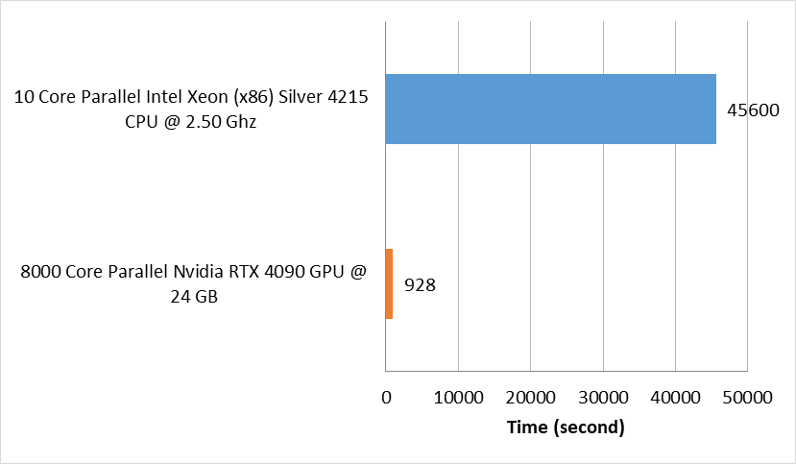
Computational Time in ORd 2011 Simulation
Simulation time comparison between GPU and CPU in ORd 2011
To assess computational efficiency, we compared GPU-based and CPU-based simulations of the ORd 2011 model. The GPU simulation, leveraging an NVIDIA RTX 4090, demonstrated superior performance, completing 8,000 simulations (across 4 drugs and 2,000 samples per drug) in a fixed 928 seconds. In contrast, the CPU simulation, utilizing a 10-core Intel Xeon Silver 4215, exhibited linear scaling, requiring approximately 45,600 seconds for the same task. The GPU's fixed runtime advantage made it significantly faster for simulations involving 163 samples or more.

Slide 26
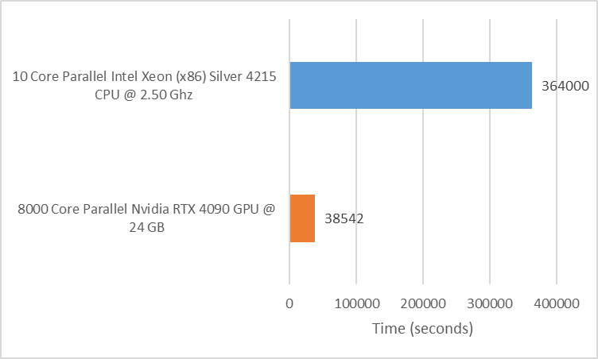
Computational Time in ToR-ORd Simulation
Simulation time comparison between GPU and CPU in ToR-ORd cell model
The computational performance of the ToR-ORd cell model was evaluated using an NVIDIA RTX 4090 GPU and a 10-core Intel Xeon (x86) Silver 4215 CPU. Both platforms simulated 8,000 samples under the same conditions. The CPU's computational time increased linearly with the number of samples and pacing due to sequential processing. In contrast, the GPU's parallel architecture ensured consistent performance, highlighting the advantages of parallelization for efficient large-scale simulations.

